Slide 1
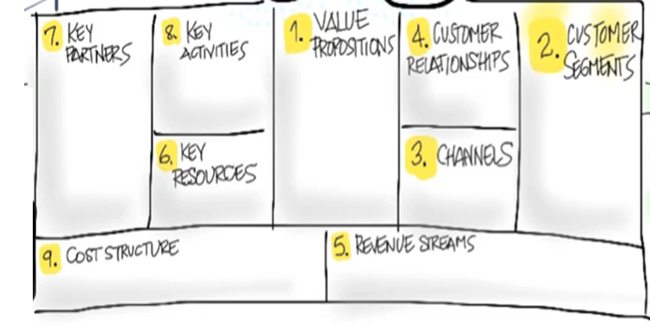
Jameson Connor Harrington, Nick Tanet, Landon Hanson, Graham Perkins
Schedule available to members
Text Chat
Send calendar events
Communication services via Text,
Scheduling and calendar events,
Reminders for events via push notification.
Feature feedback, customer feature suggestions
Automated moderation
App stores,
Calendar services,
AWS
Need for easy communication services and reliable scheduling for events and activities
Brand, apps, website, developers
Website, app
Server costs, marketing
Subscriptions, donations

